Slide 1
Chapter 3: Network Protocols and Communication
Instructor Materials
CCNA Routing and Switching
Introduction to Networks v6.0
Notes:
Cisco Networking Academy Program
Introduction to Networks v6.0
Chapter 3: Network Protocols and Communication

Slide 2
Instructor Materials – Chapter 3 Planning Guide
This PowerPoint deck is divided in two parts:
Instructor Planning Guide
Information to help you become familiar with the chapter 3
Teaching aids
Instructor Class Presentation
Optional slides that you can use in the classroom
Begins on slide # 12
Note: Remove the Planning Guide from this presentation before sharing with anyone.
Notes:
2

Slide 3
Chapter 3: Network Protocols and Communication
Introduction to Networks 6.0 Planning Guide
Notes:
Cisco Networking Academy Program
Introduction to Networks v6.0
Chapter 3: Network Protocols and Communication

Slide 4
Chapter 3: Activities
What activities are associated with this chapter?
Page # | Activity Type | Activity Name | Optional?
3.0.1.2 | Class Activity | Designing a Communications System | Optional
3.2.2.5 | Interactive Activity | Mapping the Protocols of the TCP/IP Suite | Optional
3.2.3.4 | Lab | Researching Networks Standards | Optional
3.2.4.5 | Interactive Activity | Identify Layers and Functions | Recommended
3.2.4.6 | Packet Tracer | Investigating the TCP/IP and OSI Models in Action | Optional
3.3.1.5 | Interactive Activity | Identify the PDU Layer | Recommended
3.4.1.1 | Lab | Installing Wireshark | Optional
3.4.1.2 | Lab | Using Wireshark to View Network Traffic | Optional
3.4.1.3 | Class Activity | Guaranteed to Work | Optional
The password used in the Packet Tracer activities in this chapter is: PT_ccna5
Notes:
4

Slide 5
Chapter 3: Assessment
Students should complete Chapter 3, “Assessment” after completing Chapter 3.
Quizzes, labs, Packet Tracers and other activities can be used to informally assess student progress.
Notes:
5

Slide 6
Chapter 3: Best Practices
Prior to teaching Chapter 3, the instructor should:
Complete Chapter 3, “Assessment.”
The objectives of this chapter are:
Describe the types of rules that are necessary to successfully communicate.
Explain why protocols are necessary in network communication.
Explain the purpose of adhering to a protocol suite.
Explain the role of standards organizations in establishing protocols for network interoperability.
Explain how the TCP/IP model and the OSI model are used to facilitate standardization in the communication process.
Explain how data encapsulation allows data to be transported across the network.
Explain how local hosts access local resources on a network.
Notes:
6

Slide 7
Chapter 3: Best Practices (Cont.)
Many concepts will be explored further in subsequent chapters. Each layer of the OSI will be discussed in its own chapter.
Section 3.1
Use the mail analogy to introduce how data will be sent across a network.
Discuss the rules of addressing a letter and why the Post Office has these rules.
Section 3.2
Discuss how protocols are used in human communication and how they are used in networking.
Explain the role of protocols in facilitating interoperability in network communications.
Discuss the interaction between a user and a web server. Use the animation on page 3.2.2.4.
TCP/IP - Students need to memorize the layers and what protocols are found at each layer. See interactive activity 3.2.2.5.
Discuss the advantages and disadvantages of a standards-based protocol and a proprietary protocol.
Notes:
7

Slide 8
Chapter 3: Best Practices (Cont.)
Show some of the common RFCs used in networking (ex: RFC 1918, RFCs 1034 & 1035, and RFC 5952).
3.2.3.4 Lab - Researching Network Standards. Make this a class assignment and give each student one or two of the standards organizations to research and report back to the rest of the class.
Discuss why we use a layered model.
OSI – Students must memorize each layer. Suggest a mnemonic that will help with memorization. EG. Please Do Not Throw Sausage Pizza Away.
For High School students - Make 8 1/2 X 11 CARDS with each of the OSI layers, hand them out randomly and have the students line up in order without talking to each other.
Compare the OSI reference model to the TCP/IP protocol model. Direct students to complete interactive activity 3.2.4.5-OSI Layer Functions and TCP/IP layer functions
3.3
Stress the importance of understanding the encapsulation process. Remind students of the mail analogy and addressing the envelope. Use the animation 3.3.1.3 – encapsulation and 3.3.1.4 –de-encapsulation to demonstrate.
Notes:
8

Slide 9
Chapter 3: Best Practices (Cont.)
Students should memorize the PDUs at each layer. Have them create their own mnemonic to help.
Have students reinforce their understanding of encapsulation by completing interactive activity 3.3.1.5.
Discuss the role of Network addresses (IP) and Data Link addresses (MAC) in the delivery of data. Point out that the source and destination IP addresses stay the same in the packet throughout the process but that the MAC addressing changes as a frame is sent from router to router.
Create the network used in the diagram on 3.3.2.3 and 3.3.2.4 in Packet Tracer. Use this to demonstrate how data is transferred in the LAN and then how it is transferred when going outside the LAN to another network.
Using simulation mode and filtering ICMP packets, send a simple packet from a PC in the LAN to another PC in same LAN.
In the Event list you can click on various steps and show the addressing at each step.
Do this from a PC on one LAN to a PC on the other LAN and use the Event list to show addressing at each router.
Notes:
9

Slide 10
Chapter 3: Additional Help
For additional help with teaching strategies, including lesson plans, analogies for difficult concepts, and discussion topics, visit the CCNA Community at: https://www.netacad.com/group/communities/community-home
Best practices from around the world for teaching CCNA Routing and Switching: https://www.netacad.com/group/communities/ccna
If you have lesson plans or resources that you would like to share, upload them to the CCNA Community in order to help other instructors.
Students can enroll in Introduction to Packet Tracer (self-paced).
Notes:
10

Slide 12
Chapter 3: Network Protocols and Communication
CCNA Routing and Switching
Introduction to Networks v6.0
Notes:
Cisco Networking Academy Program
Introduction to Networks v6.0
Chapter 3: Network Protocols and Communication

Slide 13
Chapter 3 - Sections & Objectives
3.1 Rules of Communication
Explain how rules facilitate communication.
Describe the types of rules that are necessary to successfully communicate.
3.2 Network Protocols and Standards
Explain the role of protocols and standards organizations in facilitating interoperability in network communications.
Explain why protocols are necessary in network communication.
Explain the purpose of adhering to a protocol suite.
Explain the role of standards organizations in establishing protocols for network interoperability.
Explain how the TCP/IP model and the OSI model are used to facilitate standardization in the communication process.
3.3 Data Transfer in the Network
Explain how devices on a LAN access resources in a small to medium-sized business network.
Explain how data encapsulation allows data to be transported across the network.
Explain how local hosts access local resources on a network.
Notes:
13
Cisco Networking Academy Program
Introduction to Networks v6.0
Chapter 3: Network Protocols and Communication

Slide 14
3.1 Rules of Communication
Notes:
3 – Network Protocols and Communication
3.1 – Rules of Communication

Slide 15
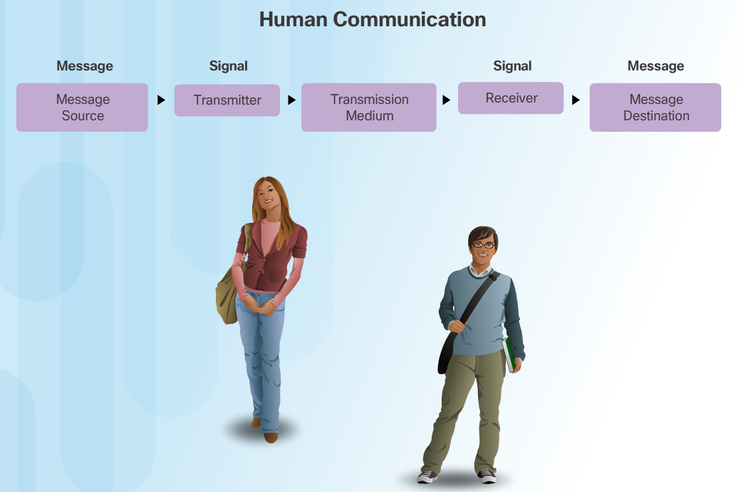
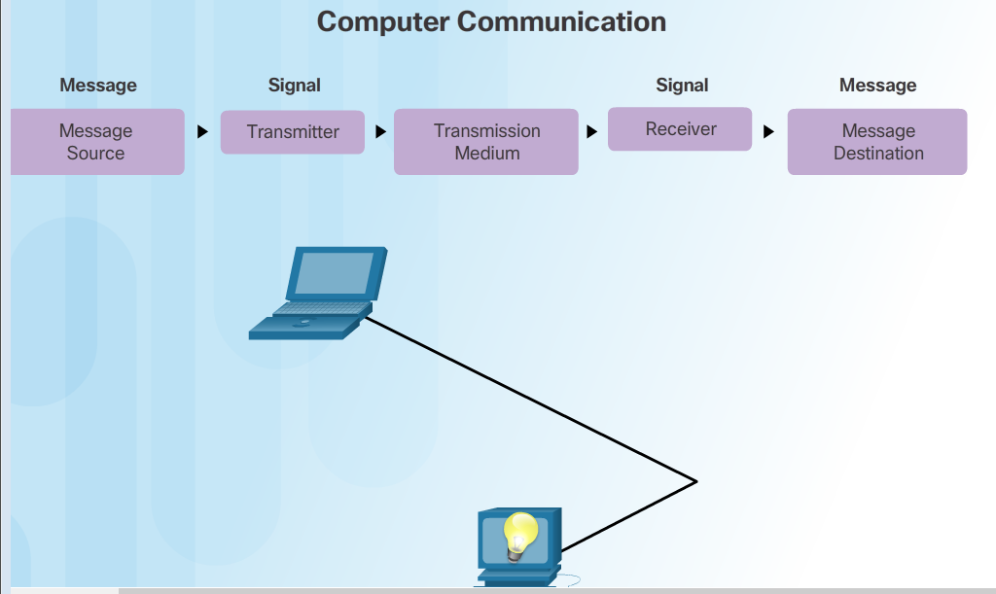
The Rules Communication Fundamentals
All communication methods have three elements in common:
Source or sender
Destination or receiver
Channel or media
Rules or protocols govern all methods of communication.
Notes:
3.1 – Rules of Communication
3.1.1 – The Rules
3.1.1.1 – Communication Fundamentals

Slide 16
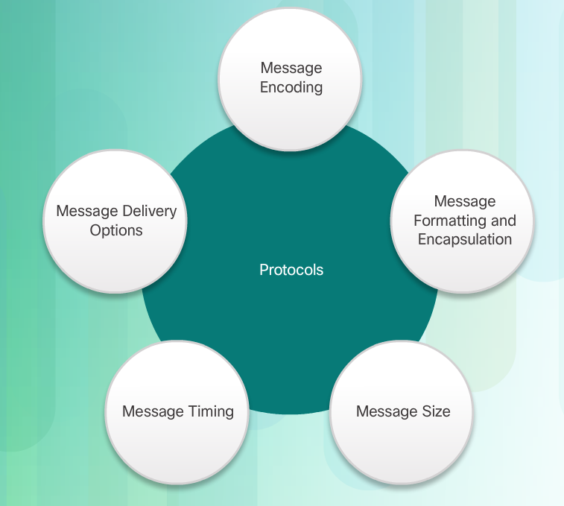
The Rules Rule Establishment
Protocols are necessary for effective communication and include:
An identified sender and receiver
Common language and grammar
Speed and timing of delivery
Confirmation or acknowledgment requirements
Protocols used in network communications also define:
Message encoding
Message delivery options
Message Formatting and Encapsulation
Message Timing
Message Size
Notes:
3.1 – Rules of Communication
3.1.1 – The Rules
3.1.1.2 – Rule Establishment

Slide 17
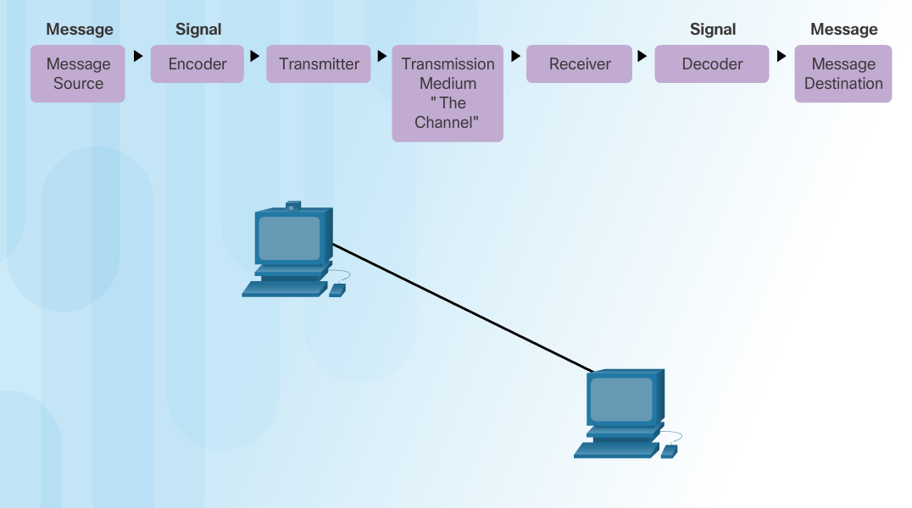
The Rules Message Encoding
Encoding between hosts must be in appropriate format for the medium.
Messages are first converted into bits by the sending host.
Each bit is encoded into a pattern of sounds, light waves, or electrical impulses depending on the network media
The destination host receives and decodes the signals in order to interpret the message.
Notes:
3.1 – Rules of Communication
3.1.1 – The Rules
3.1.1.3 – Message Encoding

Slide 18
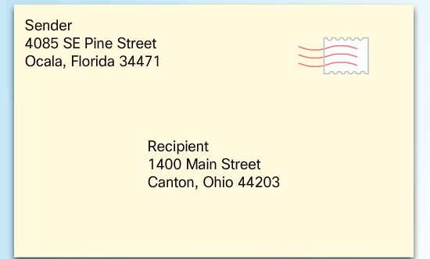
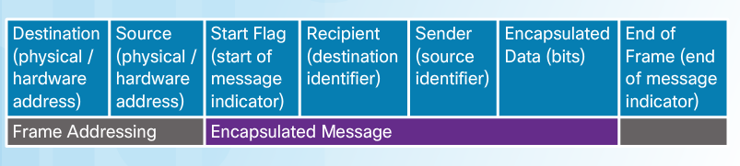
The Rules Message Formatting and Encapsulation
There is an agreed format for letters and addressing letters which is required for proper delivery.
Putting the letter into the addressed envelope is called encapsulation.
Each computer message is encapsulated in a specific format, called a frame, before it is sent over the network.
A frame acts like an envelope providing destination address and source address.
Notes:
3.1 – Rules of Communication
3.1.1 – The Rules
3.1.1.4 – Message Formatting and Encapsulation

Slide 19
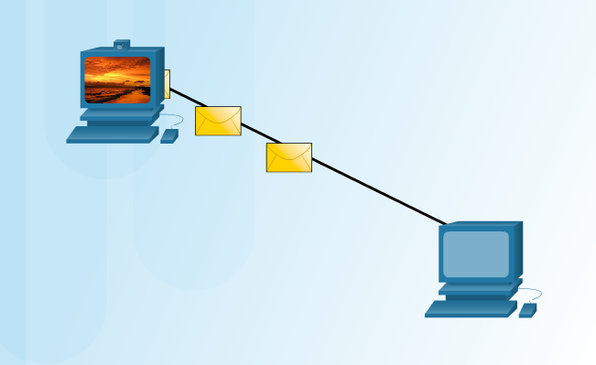
The Rules Message Size
Humans break long messages into smaller parts or sentences.
Long messages must also be broken into smaller pieces to travel across a network.
Each piece is sent in a separate frame.
Each frame has its own addressing information.
A receiving host will reconstruct multiple frames into the original message.
Notes:
3.1 – Rules of Communication
3.1.1 – The Rules
3.1.1.5 – Message Size

Slide 20
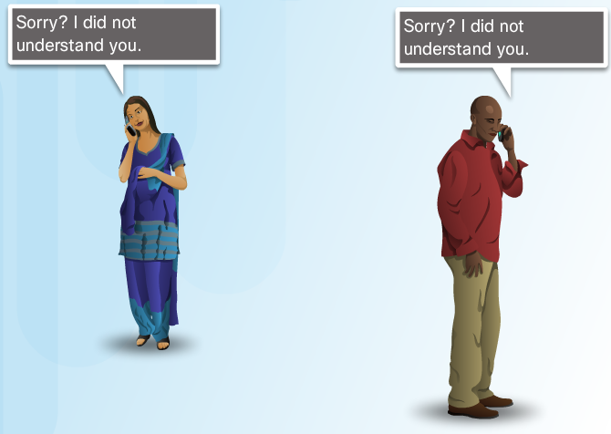
The Rules Message Timing
Access Method
Hosts on a network need to know when to begin sending messages and how to respond when collisions occur.
Flow Control
Source and destination hosts use flow control to negotiate correct timing to avoid overwhelming the destination and ensure information is received.
Response Timeout
Hosts on the network have rules that specify how long to wait for responses and what action to take if a response timeout occurs.
Notes:
3.1 – Rules of Communication
3.1.1 – The Rules
3.1.1.6 – Message Timing

Slide 21
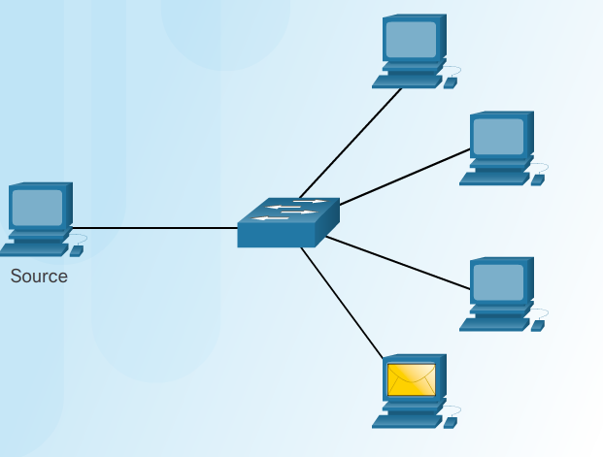
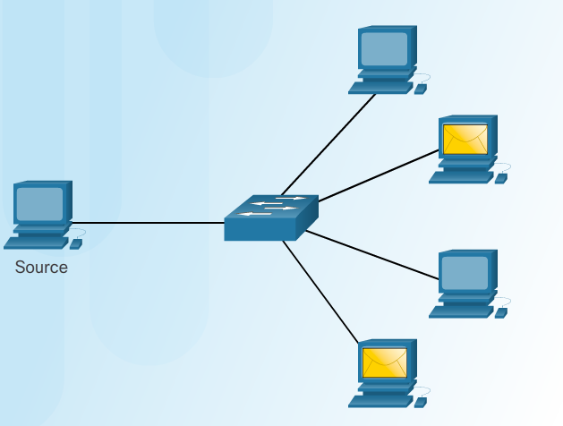
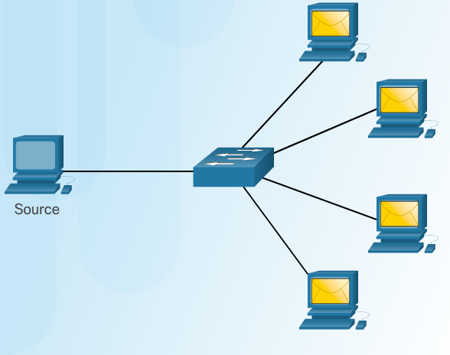
The Rules Message Delivery Options
Unicast Message Multicast Message Broadcast Message
One-to-one delivery
One-to-many delivery
One-to-all delivery
Notes:
3.1 – Rules of Communication
3.1.1 – The Rules
3.1.1.7 – Message Delivery Options

Slide 22
3.2 Network Protocols and Standards
Notes:
3– Network Protocols and Communication
3.2 – Network Protocols and Standards

Slide 23
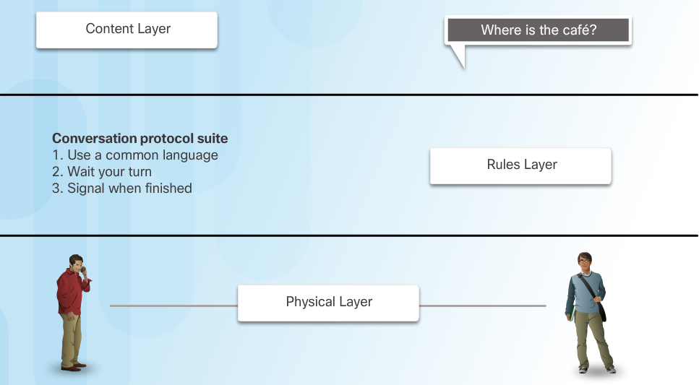
Protocols Rules that Govern Communications
Protocol suites are implemented by hosts and networking devices in software, hardware or both.
The protocols are viewed in terms of layers, with each higher level service depending on the functionality defined by the protocols shown in the lower levels.
Notes:
3.2 – Network Protocols and Standards
3.2.1 – Protocols
3.2.1.1 – Rules that Govern Communications

Slide 24
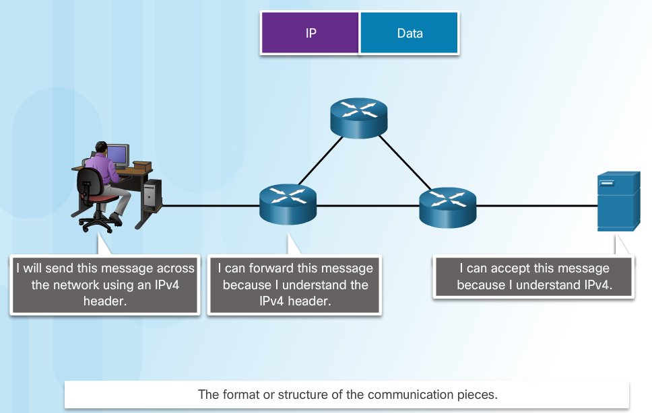
Protocols Network Protocols
Networking protocols define a common format and set of rules for exchanging messages between devices.
Some common networking protocols are Hypertext Transfer Protocol (HTTP), Transmission Control Protocol (TCP), and Internet Protocol (IP).
Notes:
3.2 – Network Protocols and Standards
3.2.1 – Protocols
3.2.1.2 – Network protocols

Slide 25
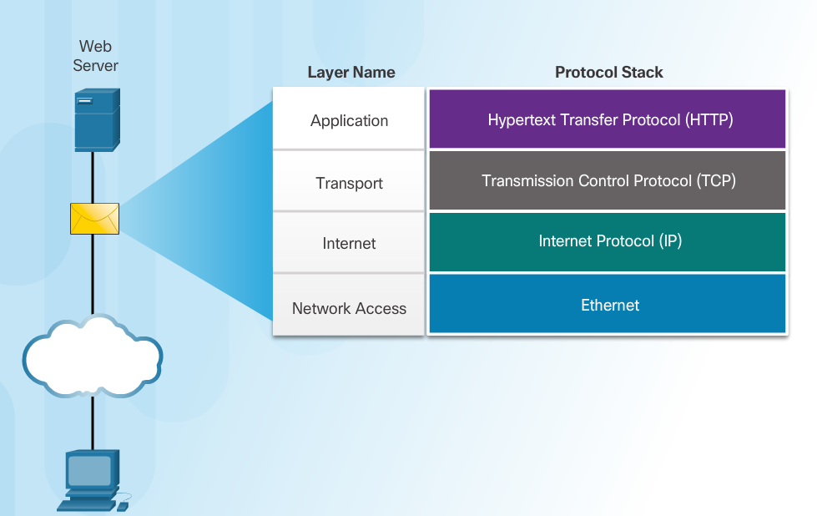
Protocols Protocol Interaction
Communication between a web server and web client is an example of an interaction between several protocols:
HTTP - an application protocol that governs the way a web server and a web client interact.
TCP - transport protocol that manages the individual conversations.
IP – encapsulates the TCP segments into packets, assigns addresses, and delivers to the destination host.
Ethernet - allows communication over a data link and the physical transmission of data on the network media.
Notes:
3.2 – Network Protocols and Standards
3.2.1 – Protocols
3.2.1.3 – Protocol Interaction

Slide 26
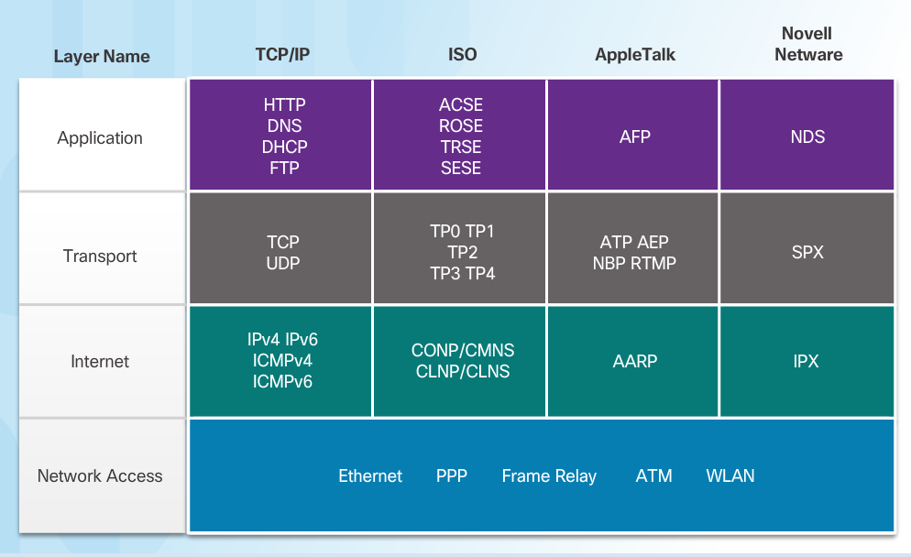
Protocol Suites Protocol Suites and Industry Standards
This course will only cover the protocols of the TCP/IP protocol suite
A protocol suite is a set of protocols that work together to provide comprehensive network communication services.
May be specified by a standards organization or developed by a vendor.
The TCP/IP protocol suite is an open standard, the protocols are freely available, and any vendor is able to implement these protocols on their hardware or in their software.
Notes:
3.2 – Network Protocols and Standards
3.2.2 – Protocol Suites
3.2.2.1 – Protocol Suites and Industry Standards

Slide 27
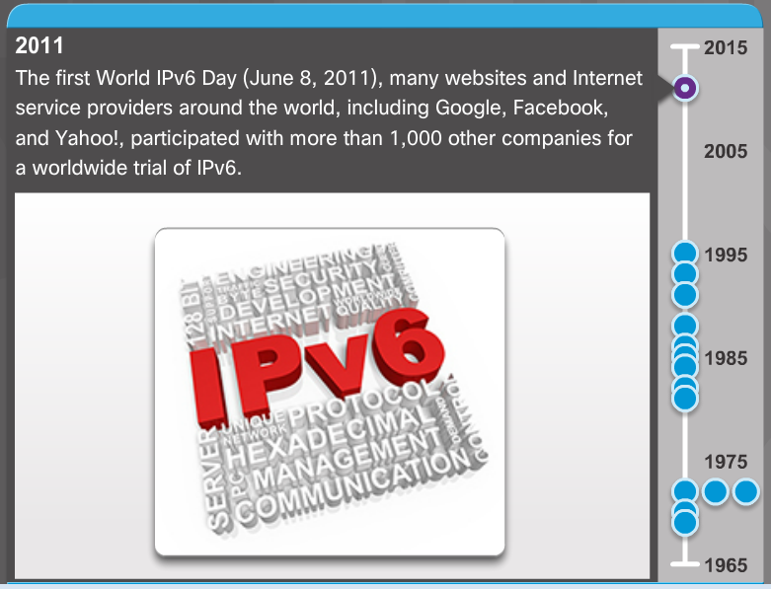
Protocol Suites Development of TCP/IP
Advanced Research Projects Agency Network (ARPANET) was the predecessor to today’s Internet.
ARPANET was funded by the U.S. Department of Defense for use by universities and research laboratories.
Notes:
3.2 – Network Protocols and Standards
3.2.2 – Protocol Suites
3.2.2.2 – Development of TCP/IP

Slide 28
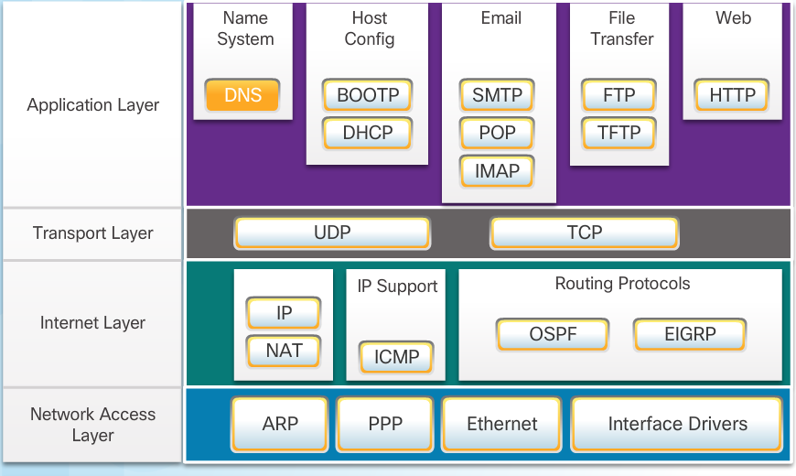
Protocol Suites TCP/IP Protocol Suite
Notes:
3.2 – Network Protocols and Standards
3.2.2 – Protocol Suites
3.2.2.3 –TCP/IP Protocol Suite

Slide 29
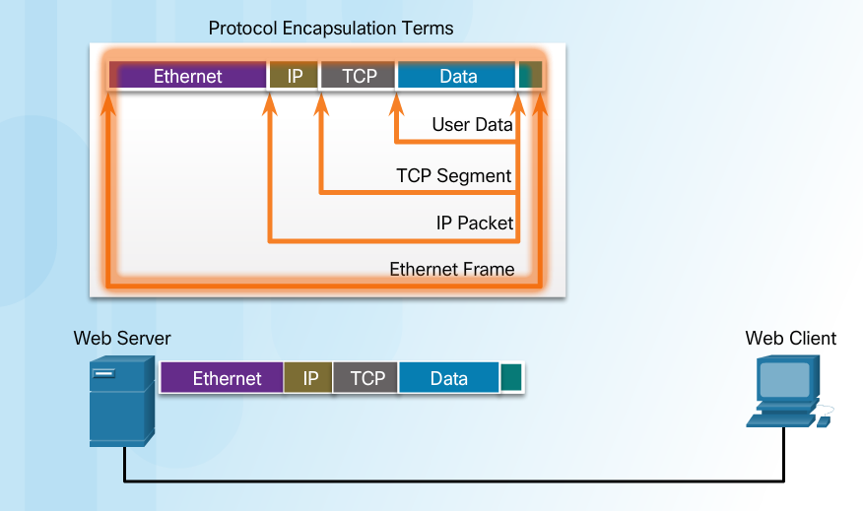
Protocol Suites TCP/IP Communication Process
When sending data from a web server to a client the encapsulation procedure would be as follows:
The webserver prepares the Hypertext Markup Language (HTML) page. The HTTP application layer protocol sends the data to the transport layer.
The transport layer breaks the data into segments and identifies each.
Next the IP source and destination addresses are added, creating an IP Packet.
The Ethernet information is then added creating the Ethernet Frame, or data link frame.
This frame is delivered to the nearest router along the path towards the web client. Each router adds new data link information before forwarding the packet.
Notes:
3.2 – Network Protocols and Standards
3.2.2 – Protocol Suites
3.2.2.4 – TCP/IP Communication Process

Slide 30
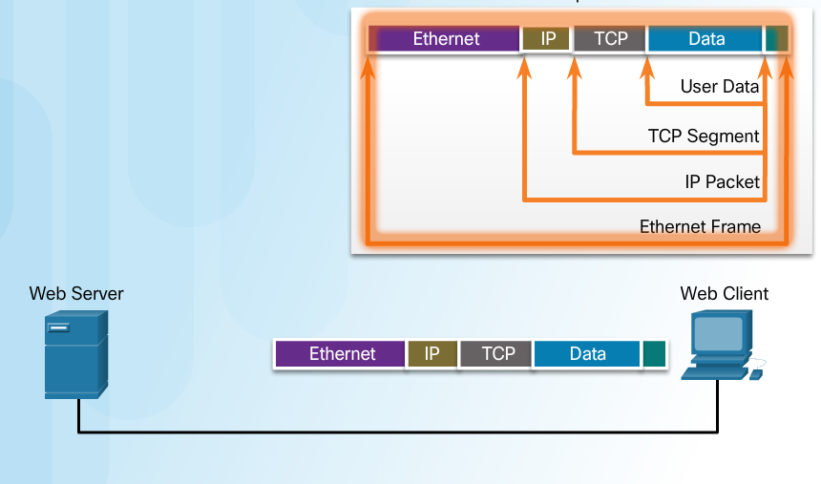
Protocol Suites TCP/IP Communication Process (Cont.)
When receiving the data link frames from the web server, the client processes and removes each protocol header in the opposite order it was added:
First the Ethernet header is removed
Then the IP header
Then the Transport layer header
Finally the HTTP information is processed and sent to the client’s web browser
Notes:
3.2 – Network Protocols and Standards
3.2.2 – Protocol Suites
3.2.2.4 – TCP/IP Communication Process (Cont.)

Slide 31
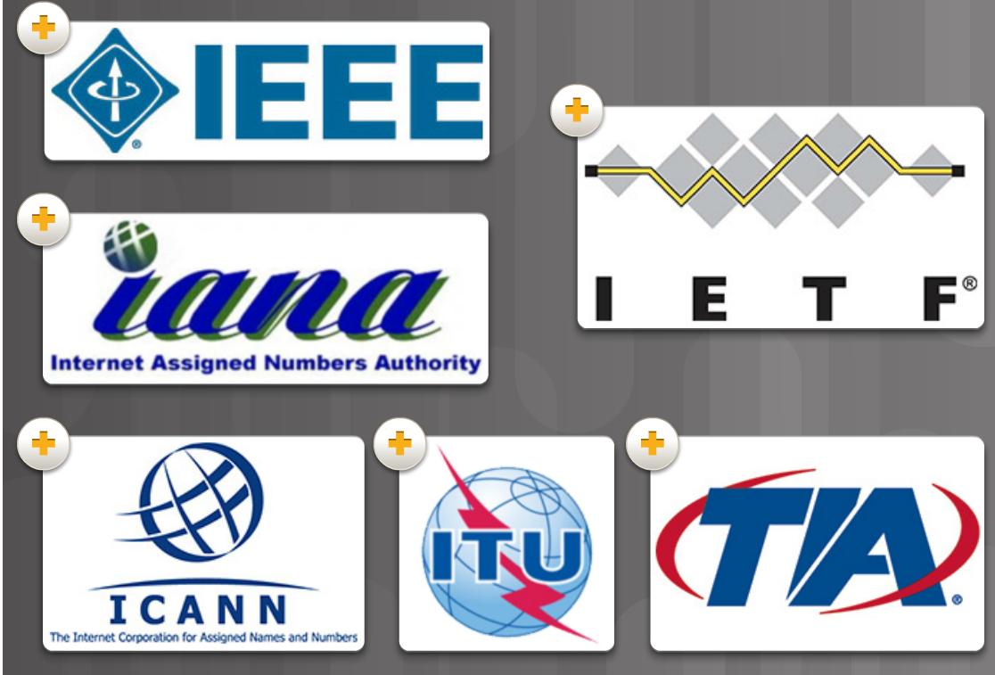
Standards Organizations Open Standards
Open standards encourage interoperability, competition, and innovation.
Standards organizations are usually vendor-neutral, non-profit organizations established to develop and promote the concept of open standards.
Notes:
3.2 – Network Protocols and Standards
3.2.3 – Standards Organizations
3.2.3.1 – Open Standards

Slide 32
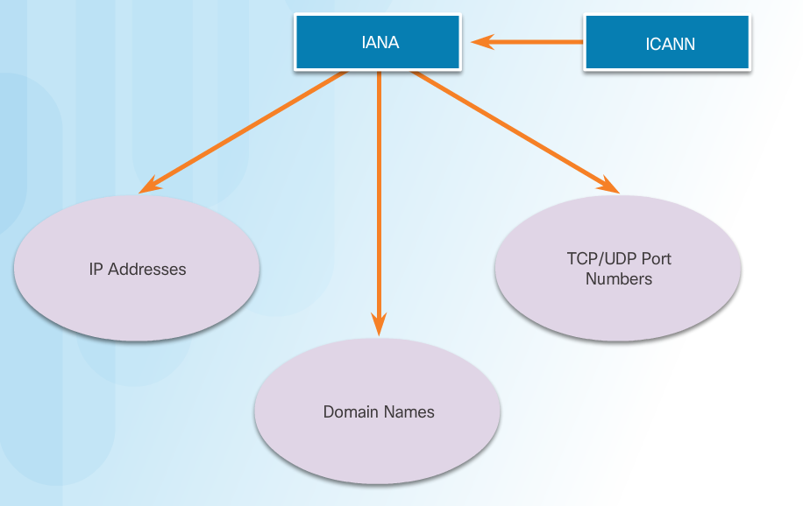
Standards Organizations Internet Standards
Internet Society (ISOC) –promotes open development and evolution of Internet use globally.
Internet Architecture Board (IAB) - management and development of Internet standards.
Internet Engineering Task Force (IETF) - develops, updates, and maintains Internet and TCP/IP technologies.
Internet Research Task Force (IRTF) - focused on long-term research related to Internet and TCP/IP protocols.
Internet Corporation for Assigned Names and Numbers (ICANN) - coordinates IP address allocation and management of domain names.
Internet Assigned Numbers Authority (IANA) - manages IP address allocation, domain name management, and protocol identifiers for ICANN.
Notes:
3.2 – Network Protocols and Standards
3.2.3 – Standards Organizations
3.2.3.2 – Internet Standards

Slide 33
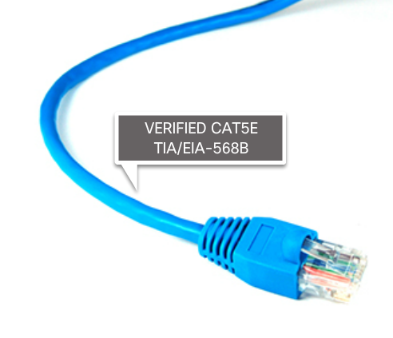
Standards Organizations Electronics and Communications Standard Organizations
Institute of Electrical and Electronics Engineers (IEEE) - dedicated to advancing technological innovation and creating standards in a wide area of industries including networking.
Electronic Industries Alliance (EIA) - standards related to electrical wiring, connectors, and network racks.
Telecommunications Industry Association (TIA) standards for radio equipment, cellular towers, Voice over IP (VoIP) devices, and satellite communications.
International Telecommunications Union-Telecommunication Standardization Sector (ITU-T) standards for video compression, Internet Protocol Television (IPTV), and broadband communications.
Notes:
3.2 – Network Protocols and Standards
3.2.3 – Standards Organizations
3.2.3.3 – Electronics and Communications Standard Organizations

Slide 34
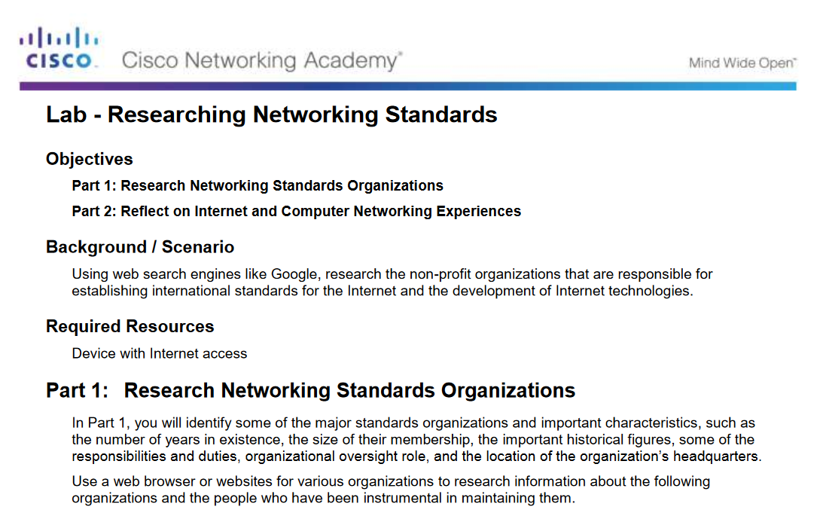
Standards Organizations Lab-Researching Networking Standards
Notes:
3.2 – Network Protocols and Standards
3.2.3 – Standards Organizations
3.2.3.4 – Lab-Researching Networking Standards

Slide 35
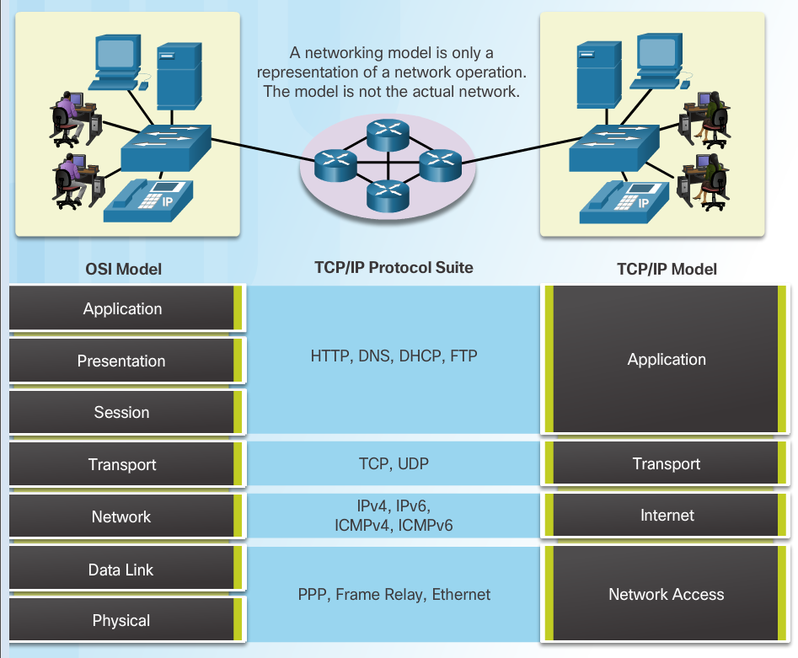
Reference Models The Benefits of Using a Layered Model
The benefits of using a layered model include:
Assisting in protocol design since protocols at each layer have defined functions.
Fostering competition because products from different vendors can work together.
Preventing technology changes in one layer from affecting other layers.
Providing a common language to describe networking functions and capabilities.
Notes:
3.2 – Network Protocols and Standards
3.2.4 – Reference Models
3.2.4.1 – The Benefits of Using a Layered Model

Slide 36
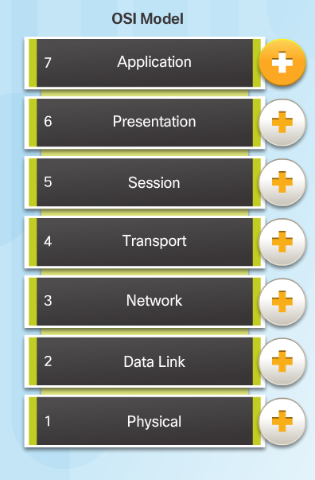
Reference Models The OSI Reference Model
Application - contains protocols used for process-to-process communications.
Presentation - provides for common representation of the data.
Session - provides services to the presentation layer to organize its dialogue and to manage data exchange.
Transport - defines services to segment, transfer, and reassemble the data.
Network - provides services to exchange the individual pieces of data over the network between identified end devices.
Data Link - provides methods for exchanging data frames between devices over a common media.
Physical - describes the mechanical, electrical, functional, and procedural means to transmit bits across physical connections.
Notes:
3.2 – Network Protocols and Standards
3.2.4 – Reference Models
3.2.4.2 – The OSI Reference Model

Slide 37
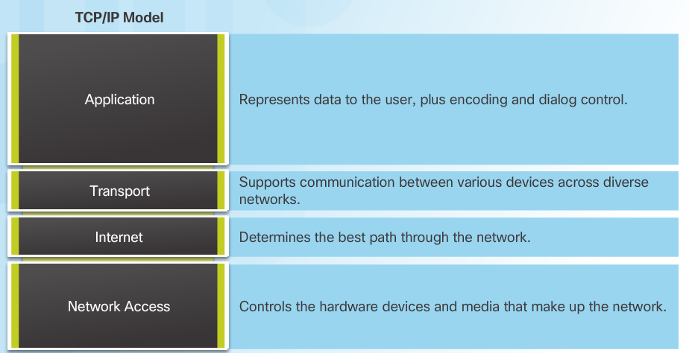
Reference Models The TCP/IP Protocol Model
The TCP/IP Protocol Model
Created in the early 1970s for internetwork communications.
Open Standard.
Also called The TCP/IP Model or the Internet Model.
Notes:
3.2 – Network Protocols and Standards
3.2.4 – Reference Models
3.2.4.3 – The TCP/IP Protocol Model

Slide 38
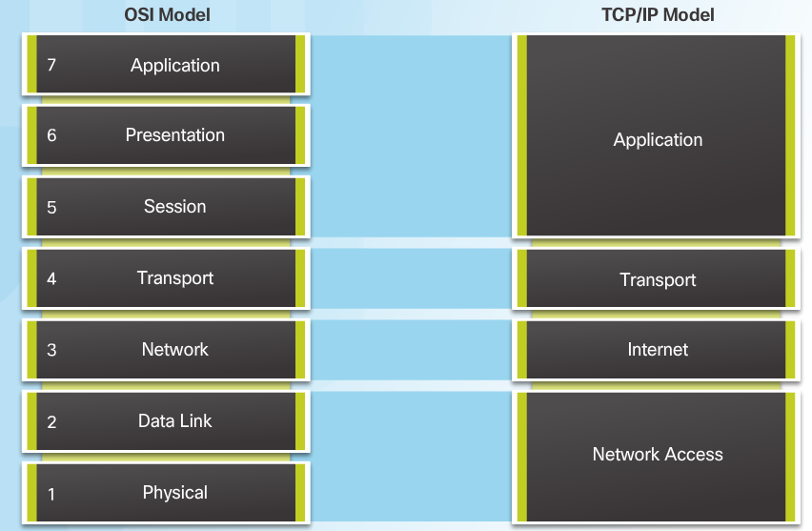
Reference Models OSI Model and TCP/IP Model Comparison
In the OSI model, the network access layer and the application layer of the TCP/IP model are further divided to describe discrete functions that must occur at these layers.
Notes:
3.2 – Network Protocols and Standards
3.2.4 – Reference Models
3.2.4.4 – OSI Model and TCP/IP Model Comparison

Slide 39
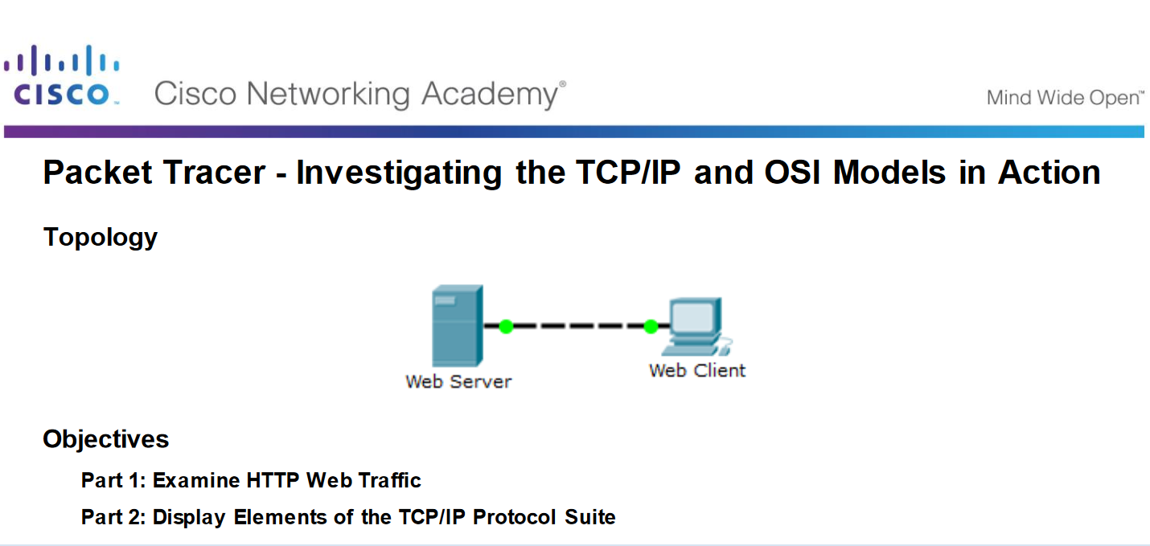
Reference Models Packet Tracer - Investigating the TCP/IP and OSI Models in Action
Notes:
3.2 – Network Protocols and Standards
3.2.4 – Reference Models
3.2.4.6 – Packet Tracer - Investigating the TCP/IP and OSI Models in Action

Slide 40
3.3 Data Transfer in the Network
Notes:
3– Network Protocols and Communication
3.3 – Data Transfer in the Network

Slide 41
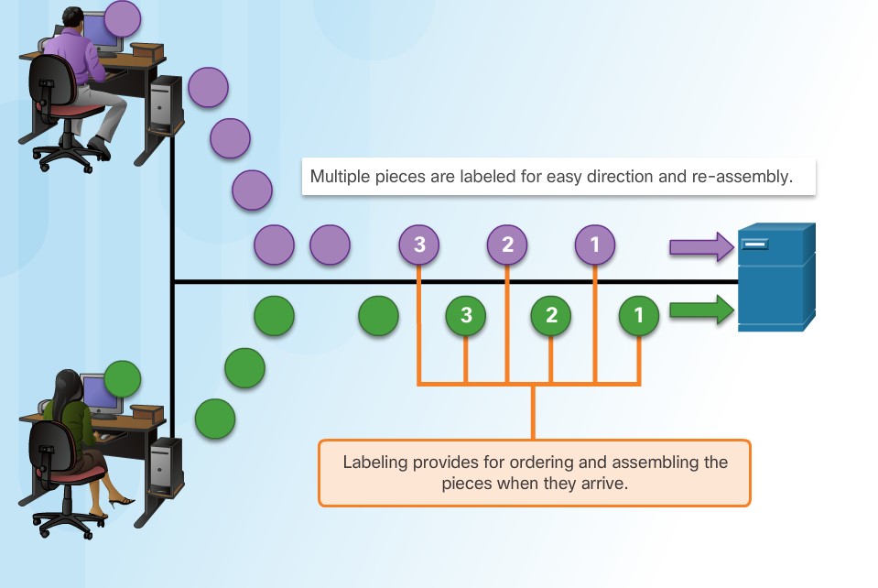
Data Encapsulation Message Segmentation
Large streams of data are divided into smaller, more manageable pieces to send over the network.
By sending smaller pieces, many different conversations can be interleaved on the network, called multiplexing.
Each piece must be labeled.
If part of the message fails to make it to the destination, only the missing pieces need to be retransmitted.
Notes:
3.3 – Data Transfer in the Network
3.3.1– Data Encapsulation
3.3.1.1 – Message Segmentation

Slide 42
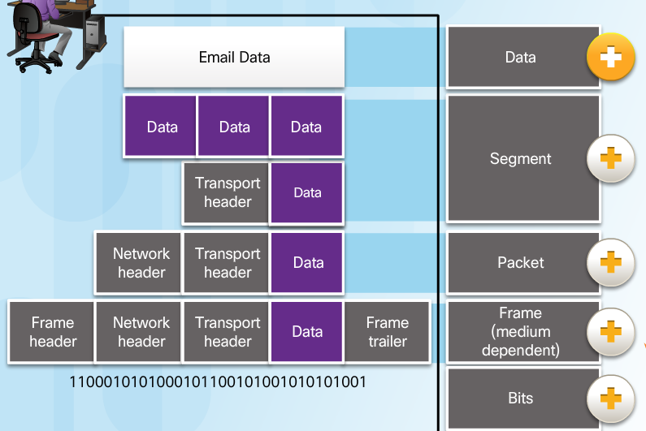
Data Encapsulation Protocol Data Units
As application data is passed down the protocol stack, information is added at each level. This is known as the encapsulation process.
The form that the data takes at each layer is known as a Protocol Data Unit (PDU).
Data - application layer PDU
Segment – Transport layer PDU
Packet – Network layer PDU
Frame – Data Link Layer PDU
Bits – Physical Layer PDU
Notes:
3.3 – Data Transfer in the Network
3.3.1– Data Encapsulation
3.3.1.2 – Protocol Data Units

Slide 43
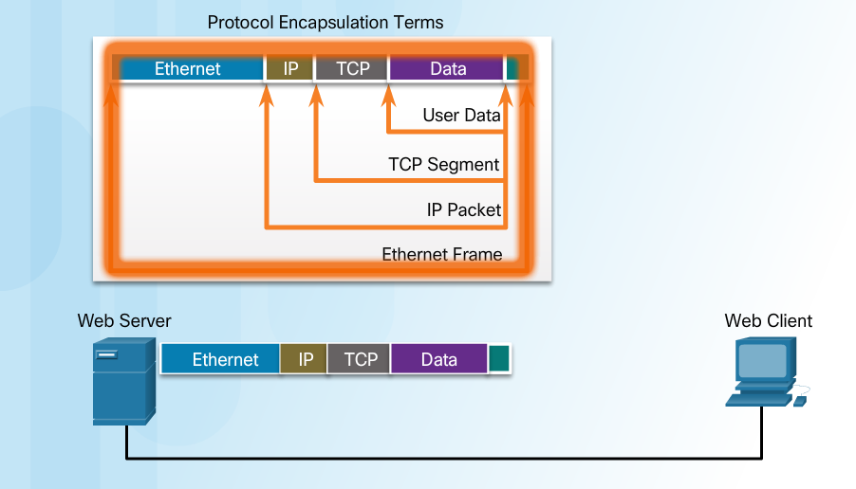
Data Encapsulation Encapsulation Example
The encapsulation process works from top to bottom:
Data is divided into segments.
The TCP segment is encapsulated in the IP Packet.
The IP packet is encapsulated in the Ethernet Frame.
Notes:
3.3 – Data Transfer in the Network
3.3.1– Data Encapsulation
3.3.1.3 – Encapsulation Example

Slide 44
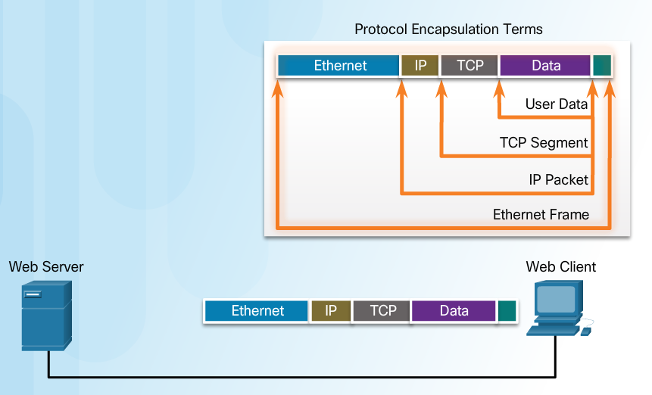
Data Encapsulation De-encapsulation
The de-encapsulation process works from bottom to top.
De-encapsulation is the process used by a receiving device to remove one or more of the protocol headers.
The data is de-encapsulated as it moves up the stack toward the end-user application.
Notes:
3.3 – Data Transfer in the Network
3.3.1– Data Encapsulation
3.3.1.4 – Encapsulation Example

Slide 45
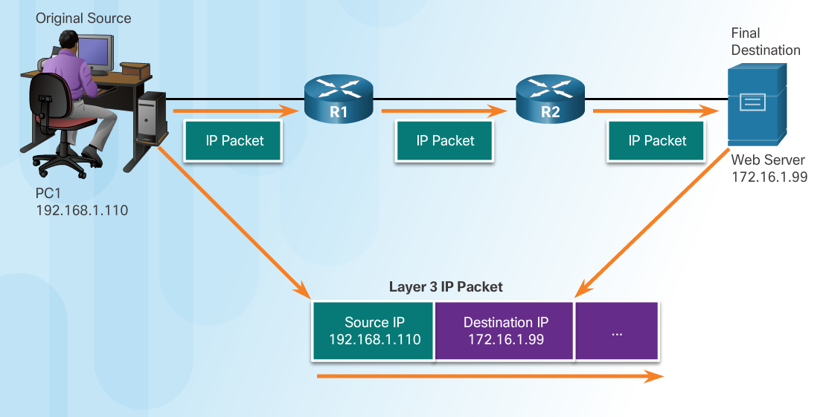
Data Access Network Addresses
Network layer source and destination addresses - Responsible for delivering the IP packet from the original source to the final destination.
Source IP address - The IP address of the sending device, the original source of the packet.
Destination IP address - The IP address of the receiving device, the final destination of the packet.
Notes:
3.3 – Data Transfer in the Network
3.3.2– Data Access
3.3.2.1 – Network Addresses

Slide 46
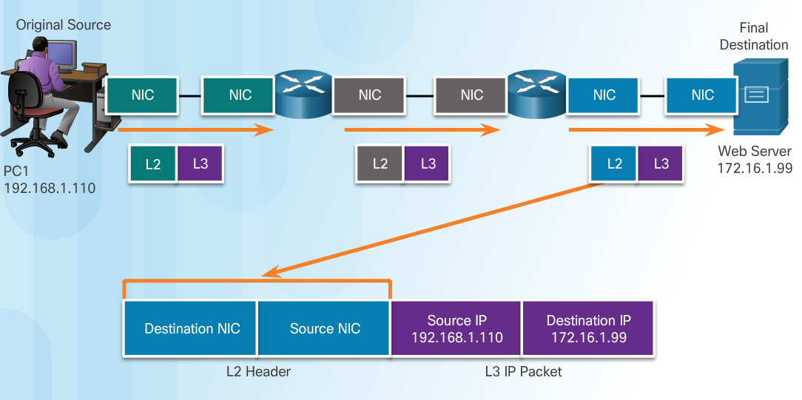
Data Access Data Link Addresses
The purpose of the data link address is to deliver the data link frame from one network interface to another network interface on the same network.
As the IP packet travels from source to destination it is encapsulated in a new data link frame when it is forwarded by each router.
Notes:
3.3 – Data Transfer in the Network
3.3.2– Data Access
3.3.2.2 – Data Link Addresses

Slide 47
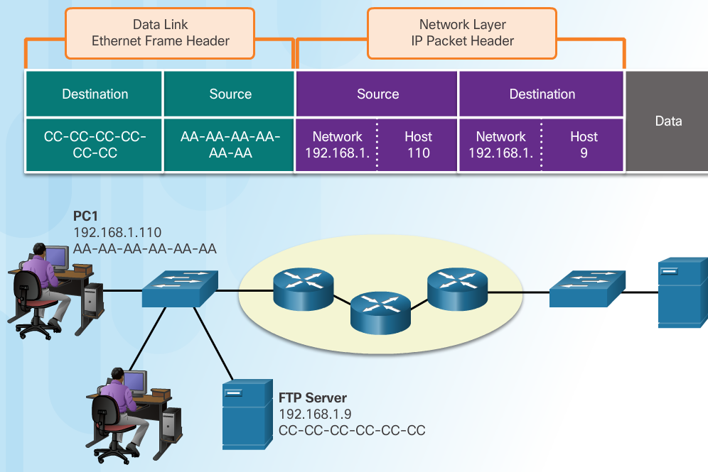
Data Access Devices on the Same Network
The network layer addresses, or IP addresses, indicate the original source and final destination.
Network portion – The left-most part of the address indicates which network the IP address is a member of.
Host portion – The remaining part of the address identifies a specific device on the network.
The data link frame which uses MAC addressing, is sent directly to the receiving device.
Source MAC address - address of sending device.
Destination MAC address – address of receiving device.
Notes:
3.3 – Data Transfer in the Network
3.3.2– Data Access
3.3.2.3 – Devices on the Same Network

Slide 48
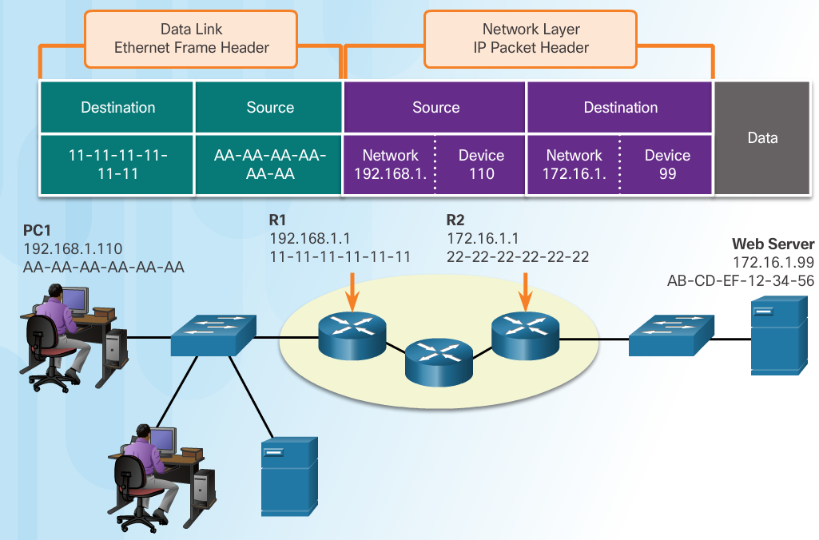
Data Access Devices on a Remote Network
Sending to a remote network - the source and destination IP addresses represent hosts on different networks.
The data link frame cannot be sent directly to the remote destination host. Therefore the frame is sent to the default gateway (nearest router interface).
The router removes the received Layer 2 information and adds new data link information before forwarding out the exit interface.
Notes:
3.3 – Data Transfer in the Network
3.3.2– Data Access
3.3.2.4 – Devices on a Remote Network

Slide 49
3.4 Chapter Summary
Notes:
3 – Network Protocols and Communication
3.4 – Summary

Slide 50
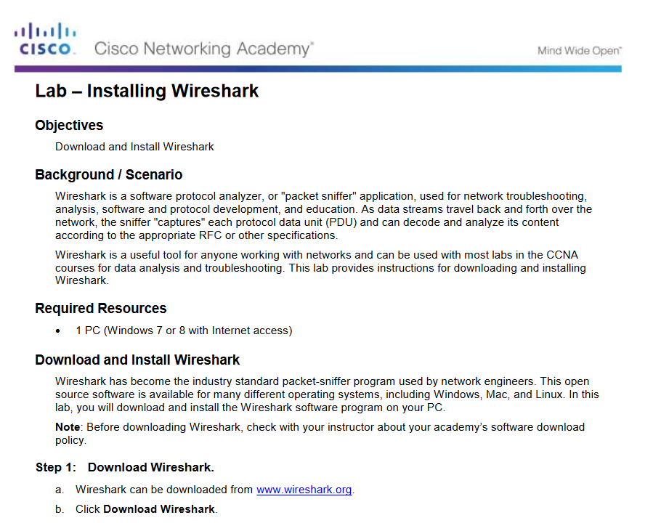
Conclusion Lab-Installing Wireshark
Notes:
3.4 – Summary
3.4.1– Conclusion
3.4.1.1 – Lab – Installing Wireshark

Slide 51
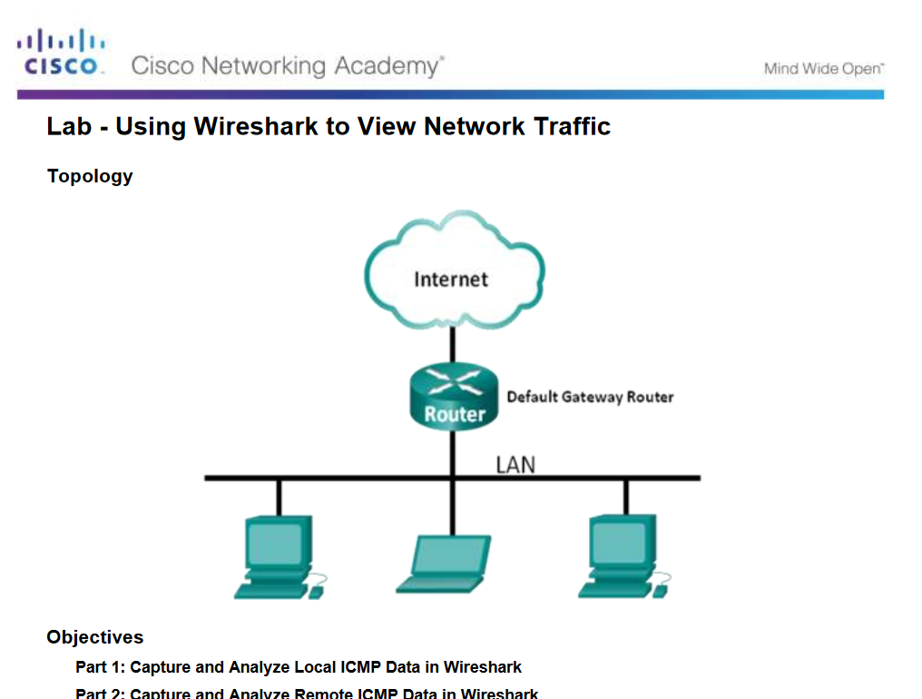
Conclusion Lab - Using Wireshark To View Network Traffic
Notes:
3.4 – Summary
3.4.1– Conclusion
3.4.1.2 – Lab – Using Wireshark to View Network Traffic

Slide 52
Conclusion Chapter 3: Network Protocols and Communications
Explain how rules facilitate communication.
Explain the role of protocols and standards organizations in facilitating interoperability in network communications.
Explain how devices on a LAN access resources in a small to medium-sized business network.
Notes:
3.4 – Summary
3.4.1– Conclusion
3.4.1.4 – Chapter 3: Network Protocols and Communications

Slide 54
New Terms and Commands
Encoding Protocol Channel Flow Control Response Timeout Acknowledgement Unicast Multicast Broadcast Protocol Suite Ethernet Standard Proprietary protocol | 802.3 (Ethernet) 802.11 (Wireless Ethernet) Segmentation Default Gateway Hypertext Transfer Protocol (HTTP) Simple Mail Transfer Protocol (SMTP) Post Office Protocol (POP) Transmission Control Protocol (TCP) Transport Data Link Network Access Advanced Research Projects Agency Network (ARPANET)
Notes:
Chapter 3: Network Protocols and Communications
New Terms and Commands

Slide 55
New Terms and Commands (Cont.)
)
Internet Message Access Protocol (IMAP) File Transfer Protocol (FTP) Trivial File Transfer Protocol (TFTP) User Datagram Protocol (UDP) Network Address Translation (NAT) Internet Control Messaging Protocol (ICMP) Open Shortest Path First (OSPF) Enhanced Interior Gateway Routing Protocol (EIGRP) Address Resolution Protocol (ARP) Dynamic Host Configuration (DHCP) | Encapsulation De-encapsulation Protocol Data Unit (PDU) Segment Packet Frame
Notes:
Chapter 3: Network Protocols and Communications
New Terms and Commands

